Slide 1
Singapore’s Land Public Transport

Slide 2
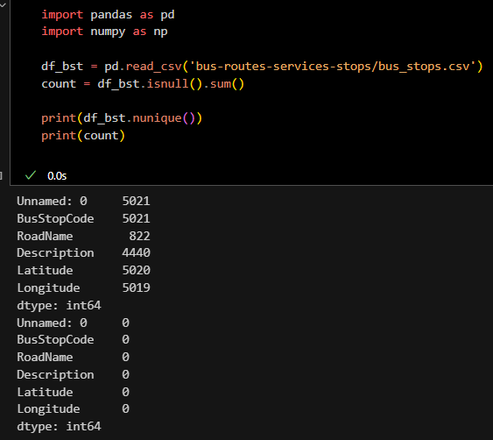
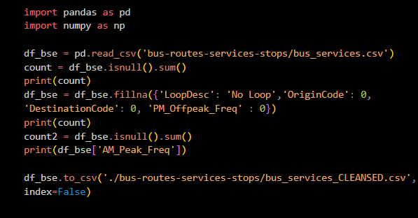
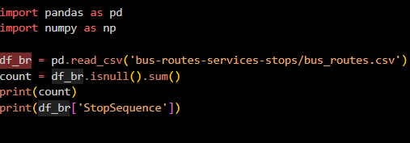
Bus datasets
For all the datasets, I wrangled by:
- finding any null values
- Filling null values with suitable values/names (eg. empty value in loop = ‘No loop’
I saved them into my folder of datasets so that they can be utilised in my main graphs.
I also plotted a pie chart and box plot to check the variables before plotting such as the percentage of operators, the start time of all buses.
Later on, I renamed some of the columns in the datasets to merge and pivot the datasets.

Slide 3
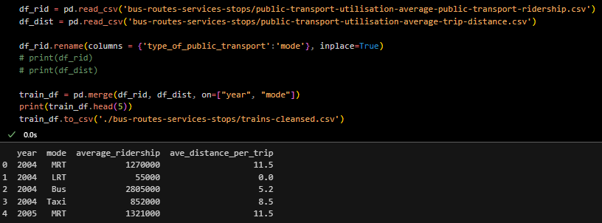
Train datasets
Next, I imported 2 datasets:
-public-transport-utilisation-average-public-transport-ridership.csv
-public-transport-utilisation-average-trip-distance.csv
These provided me the average ridership and distance per trip for every land mode of transport in Singapore (MRT, LRT, Taxi, Bus).
Similarly, I wrangled by checking for null values, changed the name of some values in order to use the pandas.merge function in order to combine the datasets, making it easier to plot.

Slide 4
Objectives
01
Best bus operator
02
Bus or MRT?
Using the time that buses start operating, coverage of bus services and efficiency of buses, I can determine which operators offer the best service.
To decide the better method of transport, I used the amount of ridership and distance travelled.

Slide 5
Objective 1:
Which operator has the best buses?

Slide 6
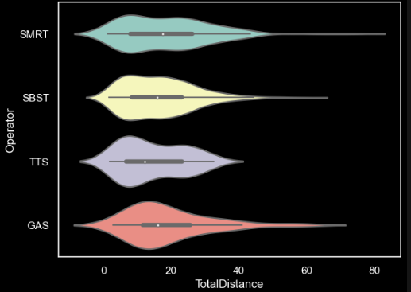
Which operator has the best buses?
–- Looking at the violin plot, we can see that SMRT and GAS offers the most in terms of distance.
- GAS has the most amount of buses that travel from about 16-20 kilometres, while TTS has the most amount of buses that travels around 10 kilometres.
- SMRT has the best distribution of buses among all 4 operators.
- All 4 bus operators have a similar median and interquartile range, but very different whiskers.
-The data goes into the negative values as it extends itself past 0 as a product of KDEs. However, there are actually no negative values.

Slide 7
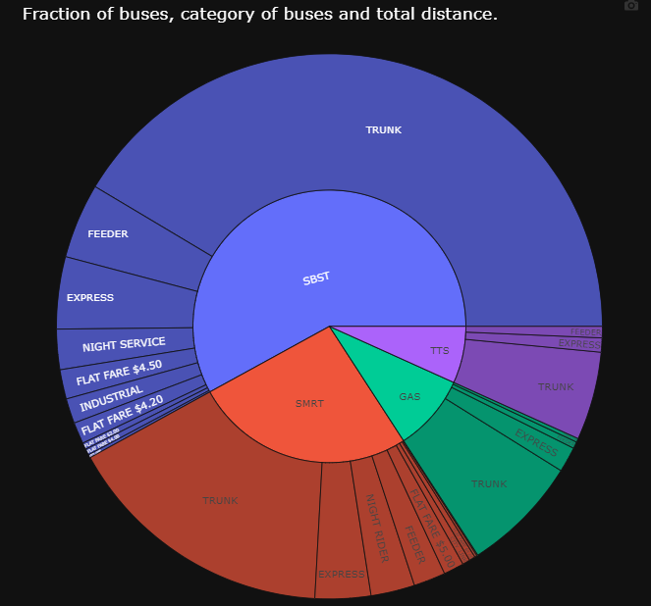
Which operator has the best buses?
Looking at this sunburst chart, we can see that SBST holds majority of the buses in Singapore, as it has more than 50% of the buses in Singapore.
SBST also hold the most number of types of buses. Even though majority of the buses are trunk buses, we can see that there are also 9 other bus types. With that, we can see that SBST has the highest coverage of Singapore.
-On the other hand, TTS has the lowest amount of bus count, as well as the lowest amount of bus types. This shows that the coverage is not as good as the other bus operators.
-

Slide 8
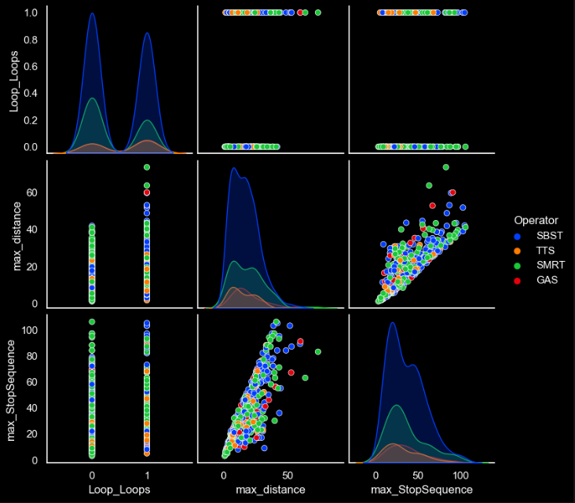
Which operator has the best buses?
In this pairplot, I will be mainly focusing on the maximum distance and maximum stop sequence.
As seen in the graph,all the operators have a similar range of distance travelled apart from TTS. However, SBST offers the highest amounts of buses, as seen from the peak being 3 times higher than its closest competitor, SMRT.
We can also see that there is no correlation between the operator and max_distance. This is because all the dots are spread out, and no color is concentrated at a spot. This proves that all the operators offer similar variety of coverage, maybe apart from SMRT which has outliers close to 75km.
This shows the efficiency in providing service for the public.

Slide 9
Objective 2:
Is MRT truly better than buses?

Slide 10
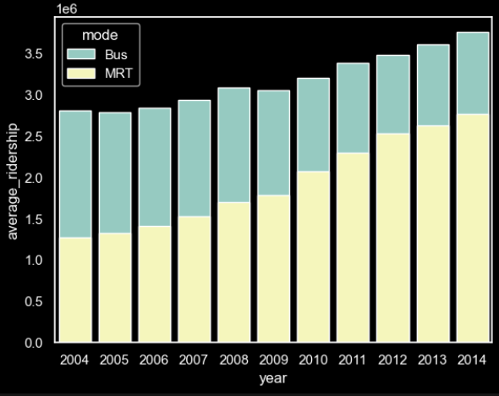
Which operator has the best buses?
To find out which operator has the best buses, I would first have to find out which public transport the public prefer more.
Looking at this stacked bar chart, we can see that the MRT was preferred in the earlier years however as time progressed, the public preferred taking buses instead.
In general, the average ridership increased from around 2.8x10^6 to 3,6x10^6. This could be explained by the public preferring to take public transport more than private ones.
By looking at the start and end year, we can also see that the ridership was equal in 2004, but became a 80/20 split in favour of the buses in 2014.

Slide 11
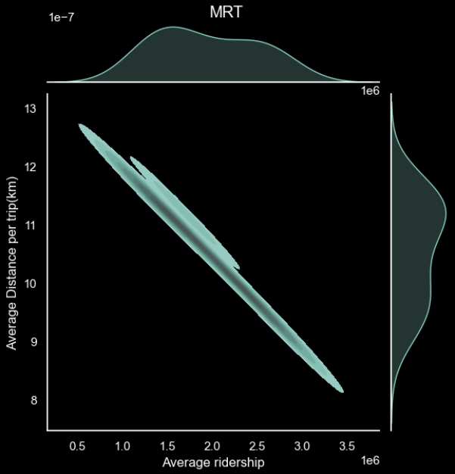
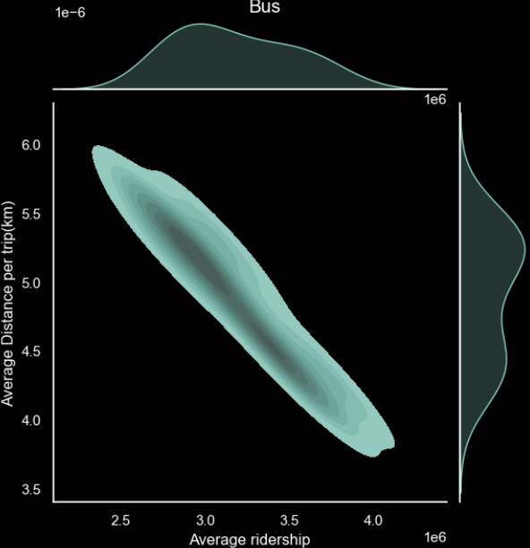
Which operator has the best buses?
Firstly, I used a jointplot in order to see if there is any correlation between the average ridership and average distance travelled per kilometre. If the distance increases while the ridership increases, this shows that the coverage is encouraging more people to take the public transport. If the distance decreases while the ridership increases, this shows that the public transport has increased interconnectedness, which encourages people to take the public transport.
With this, we can observe that there is a negative correlation between both variables in both plots. This shows that the interconnectedness has improved, because lesser people need to take the public transport for longer distances.
However, looking at the axes, there is a major difference in both riderships. We can see that more people are taking the bus and for both longer and shorter distances, as seen by the bimodal kde plot. This shows that the bus can accommodate for both types of distances better than the MRT as people are picking the bus more, as seen by the ridership range of 2.5 to 4.0x10^6, compared to the MRT’s range of 0.5 to 3.5x10^6.

Slide 12
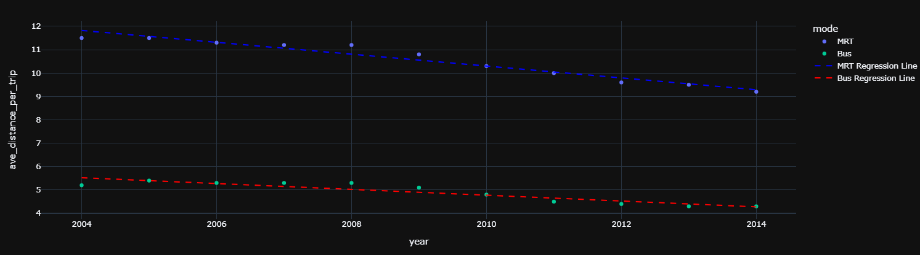
Which operator has the best buses?
Finally, I compared the average distance per trip of MRT to buses. Looking at the scatter plot, you can see that
the gradient of buses over the years have decreased lesser than the gradient of average distance of MRT trips
per year.
Using this, as the number of riderships have increased every year, we can conclude that the MRT system is getting more efficient.

Slide 13
Recommendations
Based on my objectives I have 2 recommendations:
-Increase the amount of buses that can travel longer distances by other operators apart from SBST
as well as
-Increase the coverage of MRTs, which may convince people to take the train more than buses.

